Slide 1
OBJECT ORIENTED PROGRAMM
IDEA PRESENTATION 1
ABDULLAH-AL-SAMI
ID 202411068003

Slide 2
01
02
03
04
TABLE OF CONTENTS
Title Password Manager with Encryption and HTML Export
INTRODUCTION
OBJECTIV
MOTIVATION
EXAMPLE & OUTCOME

Slide 3
01
INTRODUCTION

Slide 4
Password Manager with Encryption and HTML Export simplifies password management by securely storing, encrypting, generating, and exporting passwords for enhanced convenience and security

Slide 5
02
OBJECTIVE
You can enter a subtitle here if you need it

Slide 6




The objective of this project is to develop a simple yet robust password management tool that:
Supports features like searching, deleting, and exporting accounts in an organized manner.
Encrypts stored passwords to prevent unauthorized access.
1
2
3
4
5
Allows users to store account details securely.
Provides a password generator to create strong, unique passwords.
Enhances usability through an HTML export feature for easy access to saved account details.

Slide 7
03
MOTIVATION
You can enter a subtitle here if you need it

Slide 8
Motivation
01
Security Risks
Reusing passwords or storing them in unprotected files exposes users to potential hacking attempts.
02
Convenience
Many existing password managers are either too complex for beginners or require subscriptions.
03
Learning Experience
This project serves as an excellent opportunity to explore concepts like file handling, encryption, and user interface design in C++.

Slide 9
04
EXAMPLE & OUTCOME
You can enter a subtitle here if you need it

Slide 10
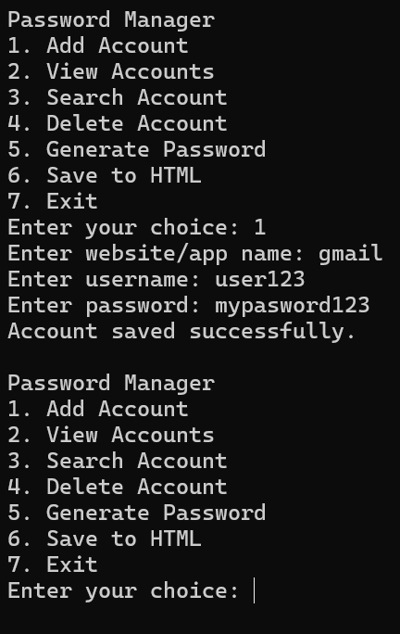
PROJECT DEMO
A user wants to store login details for their Gmail account. They:
Open the Password Manager and choose the "Add Account" option.
Enter "Gmail" as the website, "user123" as the username, and "mypassword123" as the password.
The password is encrypted and saved securely in the passwords.txt file.
Later, the user searches for "Gmail" and retrieves their decrypted login details.
The user can also generate a strong password for future accounts or export all their saved data to an HTML file.

Slide 11
PROJECT OUTCOME
Secure Storage
User-Friendly Management
Strong Password Generation
HTML Export
Protect and encrypt your passwords effortlessly.
1
2
Add, search, view, and delete accounts with ease.
3
4
Create unique and robust passwords instantly.
Organize and access saved passwords in a convenient table format.

Slide 12
THANKS!
Do you have any questions?

